Slide 1
CSCI 6234 Assignment
Group 10:
Mingqian Liu
Zhibo Sheng
Kai Wang
Junwen Wen

Slide 2
Actors
Participants: normal users
Moderators: users with extra privileges
Movie API/Server: provide movie server to system

Slide 3
Use Cases
1. Sign in/up: sign in/up to system
Preconditions: a user has an account or want to have one
Postconditions: user logged in or registered successfully
2. Sign out: sign out to system
Preconditions: a user has signed in the system
Postconditions: a user signed out successfully
3. Create watcher group: moderator creates watching groups
Preconditions: a user has logged in as a moderator
Postconditions: a watching group is created
4. Invite to group: moderator invites users to watching group
Preconditions: a user has logged in as a moderator; the watching group is created; the invited users existed
Postconditions: new users joined in the watching group

Slide 4
Use Cases
5. Join a watcher group: users join a watcher group
Preconditions:users have logged in; the watcher group existed
Postconditions: the user can access to the group
6. Unsubscribe watcher group: users unsubscribe watcher group
Preconditions: users have logged in; the watcher group existed
Postconditions: users cannot access to the group
7. Add movies: moderator populates a list movies to a watcher group
Preconditions: a user has logged in as a moderator; the watcher group existed; movie lists existed
Postconditions: a new movie list shows in the watcher group
8. Pull movie list: moderator pulls movie lists from API/server
Preconditions: a user has logged in as a moderator; known APIs/servers
Postconditions: the movie lists added to system

Slide 5
Use Cases
9. Search and browse movies: group members search and browse movies
Preconditions: users have logged in; the watcher group existed; movie lists existed; search function is existed
Postconditions: users get the results of searching and all the movies to browse
10. Watch the trailer: group members watch the trailers(populated by the moderator)
Preconditions: users have logged in; the watcher group existed; moderator has populated movies
Postconditions: a trailer is playing
11. Access to movie reviews: group members access to movie reviews(populated by the moderator)
Preconditions: users have logged in; the watcher group existed; moderator has populated movies; movie reviews existed
Postconditions: movie reviews are showing

Slide 6
Use Cases
12. Create a movie watching event: moderator creates a movie watching event
Preconditions: a user has logged in as a moderator
Postconditions: a new movie event added to system
13. Open and close a voting: moderators open and close a voting to movie events
Preconditions: a user has logged in as a moderator; a voting exists before close it; movie events existed
Postconditions: a movie event can be voted; the voting to a movie event is closed
14. Notified by events and voting: group member are notified new events and new voting
Preconditions: users have logged in; the watcher group existed; new event created; voting is open
Postconditions: group members knew the new event and new voting
15. Cast votes: group members cast votes for movies in movie events
Preconditions:users have logged in; the watcher group existed; the moderator created the events; the voting is open
Postconditions: group members their votes

Slide 7
Use Cases
16. Check histories: group members check histories of movie events, votes, and winners
Preconditions: users have logged in; the watcher group existed; the moderator created the events; the voting is closed; the winners existed
Postconditions: the histories of movie events, votes, and winners are showing

Slide 8
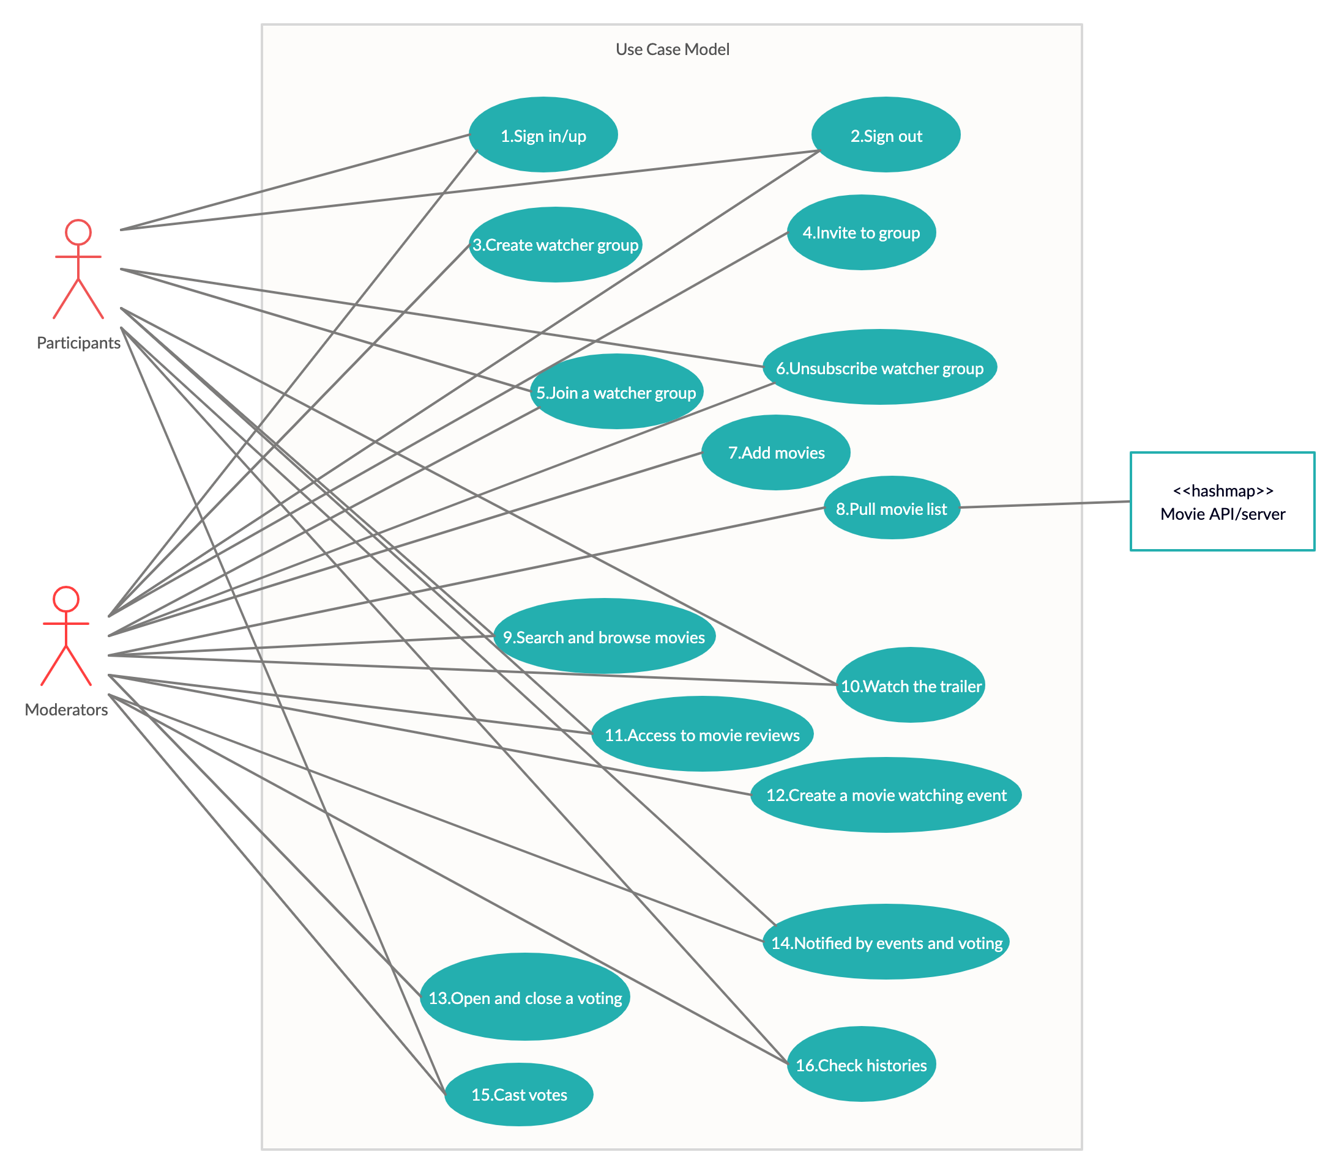
Use Case Diagram

